Slide 1

Recommendation Systems:
A recommendation system is a type of machine learning model designed to suggest items to users based on their preferences, behavior, or historical data. It is widely used in applications like e-commerce, streaming platforms, and educational websites to provide personalized experiences.

Slide 2

What are Recommendation Systems?
1
Personalized Suggestions
2
Improved User Experience
They use algorithms to analyze data and predict what users might be interested in.
They help users discover new content, products, or services, making the online experience more efficient and enjoyable.
3
Increased Engagement
By providing relevant recommendations, they can encourage users to spend more time on a platform, leading to higher engagement.

Slide 3
Types of Recommendation Algorithms
Collaborative Filtering
Content-Based Filtering
Hybrid Approaches
Utilizes the behavior of similar users to recommend items.
Recommends items based on the user's past preferences and the content of items.
Combines different algorithms to achieve a more accurate and robust recommendation system.
Example: Netflix, Hulu, Disney+
Example: Amazon, Flipkart
Example: Spotify
How it works:
How it works:
Content-Based: Suggests songs with similar audio features (e.g., genre, tempo, mood).
"People who watched Stranger Things also enjoyed The Umbrella Academy."
Suggests products similar to the ones you viewed or purchased, based on features like brand, category, price, and specifications.
Collaborative Filtering: Suggests songs liked by users with similar playlists.
Based on the viewing habits of similar users, new shows or movies are suggested.
Features considered: Brand (e.g., Apple), category (e.g., smartphone), price range.
Hybrid:
Real-life interaction: Helps you discover new shows aligned with your preferences.
After listening to upbeat pop songs:
Real-life interaction: If you browse a wireless earbud, Amazon suggests other wireless earbuds with similar features.
Content-Based: Recommends other upbeat pop songs.
Collaborative Filtering: Suggests songs popular among users with similar listening

Slide 4




Collaborative Filtering
User Similarity
Identifies users with similar tastes and preferences.
Item Recommendations
Recommends items that similar users have interacted with positively.
Prediction
Predicts the user's likelihood of liking a particular item based on the ratings of similar users.

Slide 5
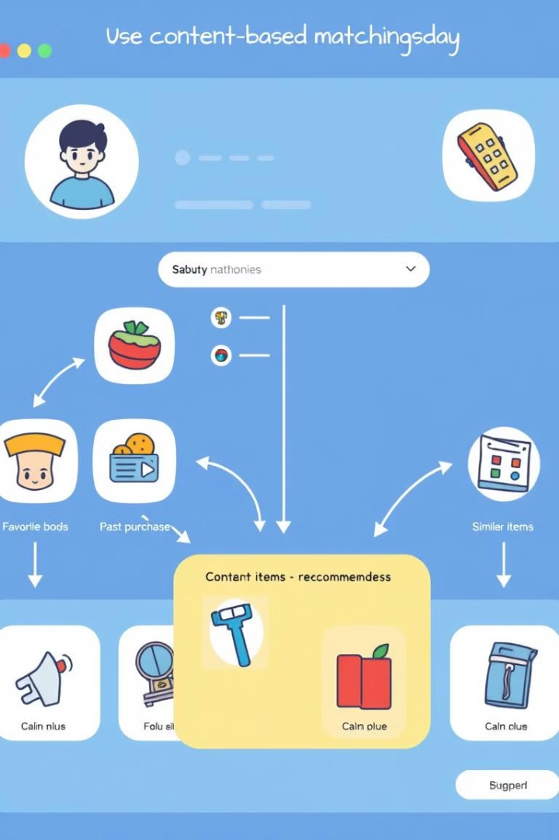
Content-Based Filtering
1
User Profile
Creates a profile based on the user's past interactions and preferences.
2
Content Analysis
Analyzes the content of items and identifies similarities to the user's profile.
3
Recommendation
Recommends items that are similar to what the user has interacted with positively in the past.

Slide 6

Hybrid Approaches
Combined Strengths
Reduced Cold Start
Leverages the advantages of multiple algorithms to provide more accurate and diverse recommendations.
Combines collaborative and content-based filtering to overcome the challenge of recommending items to new users.
Improved Accuracy
Hybrid approaches can often achieve higher accuracy compared to individual algorithms.

Slide 7

Coursera Recommendation System
CASE STUDY
Coursera uses recommendation systems to personalize the learning experience by suggesting courses, specializations, and other educational content tailored to individual users.
User Profile
Enrolled courses, Learning Goals, Skills
Content Analysis
Course descriptions, Instructor profiles, Learning outcomes
Recommendation Algorithm
Hybrid approach combining collaborative and content-based filtering
Recommendations
Personalized suggestions for relevant courses, specializations, and learning paths.

Slide 8
Types of Recommendations
Coursera provides several types of recommendations:
Course Recommendations: Based on user preferences, learning history, and behavior.
Specialization Recommendations: Groups of related courses curated for a specific learning goal.
Career or Skill-Based Recommendations: Based on career aspirations or skills the user wants to build.
Trending Courses: Popular courses among other users in similar demographics or regions.

Slide 9
Techniques Used
Coursera employs a mix of machine learning techniques for its recommendation systems:
A. Collaborative Filtering
Uses data from many users to recommend content that similar users have enjoyed.
Example: "Learners who took Machine Learning by Andrew Ng also took Deep Learning Specialization."
B. Content-Based Filtering
Recommends courses based on the features of the course and user preferences.
Example: If you liked a data science course, it may suggest courses with similar tags, such as Python, machine learning, or statistics.
C. Hybrid Systems
Combines collaborative and content-based filtering for improved accuracy.
Example: If you're a new user, the system might recommend popular or trending courses (content-based). As you interact more, it shifts to personalized recommendations (collaborative).

Slide 10
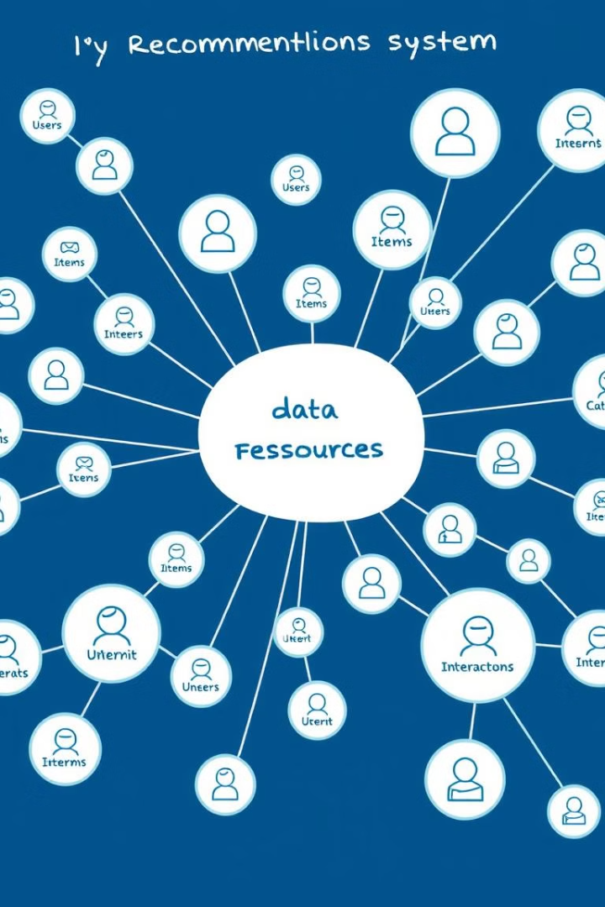
Data Sources
Coursera uses various data points for recommendations:
User Behavior:
Browsing and search history.
Completed and enrolled courses.
Time spent on specific course pages.
Course Attributes:
Topics, tags, difficulty level, language, and instructors.
User Feedback:
Ratings, reviews, and course completion status.
Peer Activity:
What other users with similar learning paths are exploring or completing.

Slide 11
Why It Works Well
Scalability: Handles millions of users and courses.
Adaptiveness: Adjusts recommendations as user preferences and global trends change.
Feedback Loops: Continuously improves through user feedback and behavior.

Slide 12
Conclusion
Coursera’s recommendation system exemplifies how personalized recommendations can drive engagement, facilitate discovery, and create meaningful learning experiences tailored to individual aspirations. By intelligently aligning user needs with its vast catalog, Coursera ensures a productive and rewarding journey for its learners.

